Slide 1
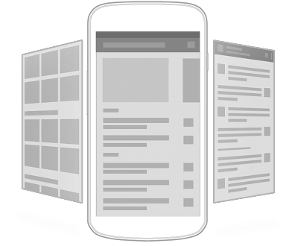
Android: Layouts
David Meredith
dave@create.aau.dk

Slide 2
Source
Android API Guide on User Interface
http://developer.android.com/guide/topics/ui/index.html

Slide 3
Introduction
The user interface (UI) is everything that the user can see and interact with
Android provides pre-built UI components such as structured layout objects and input controls that you can use to build your UI
Android also provides other modules for special interfaces such as dialogs, notifications and menus

Slide 4
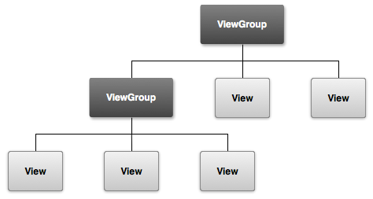
Overview
All Android UI elements built using View and ViewGroup objects
View is an object that draws something on the screen that the user can interact with
ViewGroup is a container that holds Views and other ViewGroup objects and defines layout of all or part of the screen
Views and ViewGroups for a particular screen arranged into a hierarchy

Slide 5
User interface layout
ViewGroup is an invisible container that organizes child Views (some of which might themselves be ViewGroups)
ViewGroup is a subclass of View!
Child Views inside a ViewGroup are widgets or input controls that draw some part of the UI
Make your UI no more complex than it needs to be
It takes more time and memory to construct and display a complex View hierarchy

Slide 6
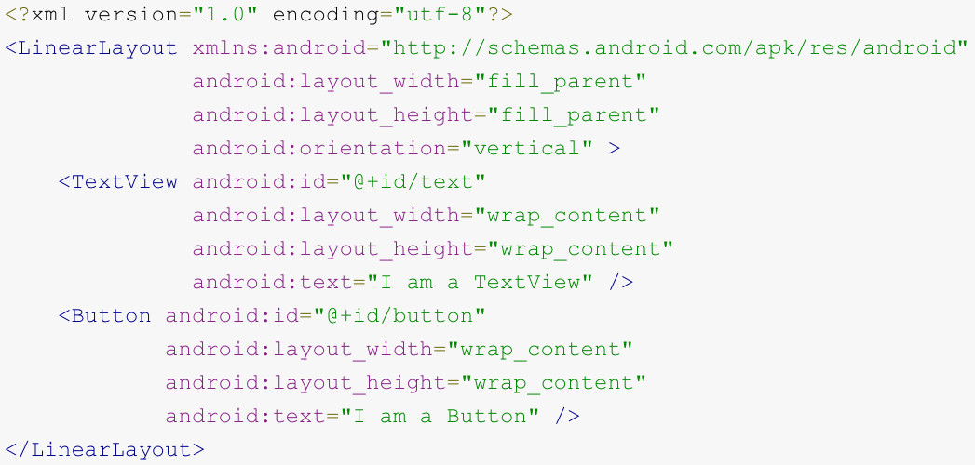
User interface layout
Declare your layout either
in code, by instantiating View objects and building a tree
in an XML layout file (PREFERRED!)
Name of XML element for a View is the same as the class name of the View (e.g., TextView, LinearLayout)
Above is a simple vertical layout with a TextView and a Button
When XML layout loaded, each node inflated into a runtime object

Slide 7
Layouts
Layout defines visual structure of a user interface
e.g., for an Activity or an app widget
You can declare Layouts either in your Java code or in an XML layout file
Can declare default layouts in XML
Modify state of UI components in your code

Slide 8
Declaring UI in XML resource
Declaring UI in XML resource lets you separate presentation from logic and behaviour
Can modify presentation without changing code
Can create XML layouts for different screen orientations, sizes and densities or different languages
Easier to debug when layout defined in XML

Slide 9
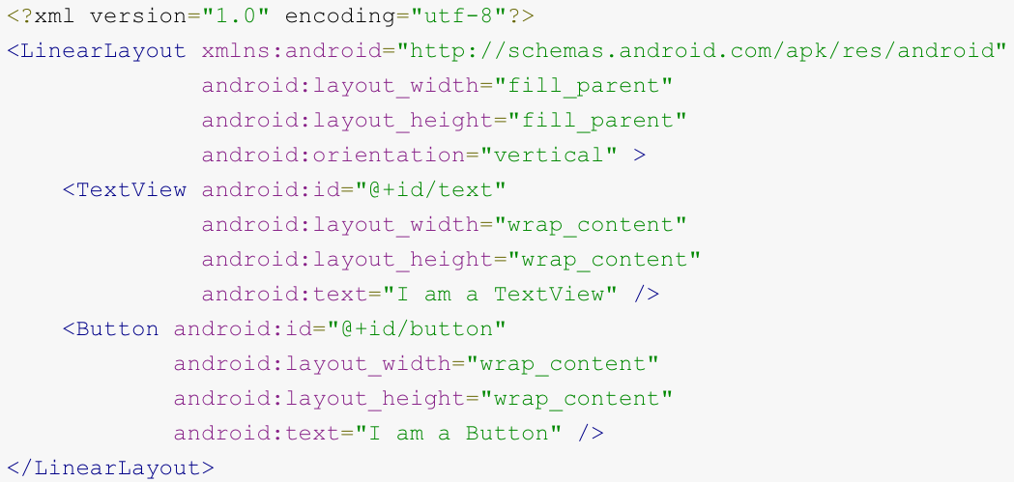
Defining layout in XML
XML vocabulary for defining layouts follows naming of classes and methods
XML element names correspond to class names
XML attribute names correspond to methods
Though there are a couple of small differences
e.g., EditText.setText() corresponds to text attribute

Slide 10
Writing an XML layout file
Each layout file contains one root element, which must be (i.e., correspond to) a View or a ViewGroup object
This will usually be a Layout
Layout is a subclass of ViewGroup!
The root element contains child elements which correspond to Views (often widgets) and ViewGroups (often Layouts)
The layout XML file should end with “.xml” and be stored in the res/layout/ directory

Slide 11
Loading an XML layout resource
When app is compiled, each XML layout file is compiled into a View resource
Load the layout by calling setContentView() from the onCreate() callback implementation in your Activity class
Pass setContentView() the id of the layout resource, as defined in the R.java file
Example shows case for layout declared in main_layout.xml

Slide 12
Attributes
Each View and ViewGroup element in an XML layout file has its own set of attributes (e.g., id, text)
These attributes are inherited by any class that subclasses View or ViewGroup
Some attributes are layout parameters that describe layout orientations of a View object (e.g., layout_width, layout_height)

Slide 13
ID
Any View object may have an integer ID
Assigned in id attribute as a string
Associated with an integer constant in R.java
@: indicates the type of the value following the slash
in this case, an “id” type resource
+: indicates that this is the first time the resource is being defined and that it should be added to R.java

Slide 14
Android resources
You can also access a number of Android framework IDs
Here you do not use the “+” symbol, since you are not defining the ID, just using one that has already been defined
You declare the type of the resource to be “@android:id” to indicate that the id is defined in the android package namespace
“android” namespace means referencing a resource defined in android.R resources class, not private resources class

Slide 15
Creating and referencing Views
First define the view or widget in the layout file and assign a unique id
Then create an instance of the View and capture it from the layout (usually in onCreate())
In a RelativeLayout, often need to define View position relative to other sibling Views, referred to by their IDs
ID should be unique throughout the entire View tree

Slide 16
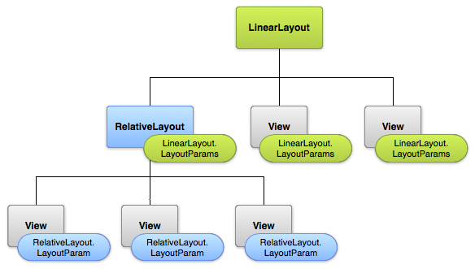
Layout parameters
XML layout attributes with name layout_something define layout parameters
A ViewGroup implements a nested class that extends ViewGroup.LayoutParams
i.e., a class called LayoutParams, defined inside ViewGroup
The ViewGroup.LayoutParams class inside a ViewGroup defines size and position of each of its child Views

Slide 17
Layout parameters
Every LayoutParams subclass has its own syntax for setting values
Each child element must define LayoutParams appropriate for its parent
A child ViewGroup may also define different LayoutParams for its own children

Slide 18
layout_width and layout_height
Every ViewGroup.LayoutParams defines a width (layout_width) and height (layout_height)
Every view in the ViewGroup must define these in its XML declaration
Many ViewGroups also include optional margins and borders
layout_width and layout_height can be defined by absolute distances (DISCOURAGED!)
Usually define layout_width and layout_height using a constant such as
wrap_content – View expands to size of content
fill_parent or match_parent – View as big as parent will allow
Can also use density-independent pixel units (dp)

Slide 19
Layout position
L
T
View controls a rectangular area in the UI
View has left, top, width and height properties, expressed in pixels relative to the parent
Has getter methods: getLeft(), getTop(), getWidth(), getHeight()
H
W

Slide 20
Size, padding and margins of a View
T
getWidth(), getHeight()
actual width and height of View on screen at drawing time after layout
getMeasuredWidth(), getMeasuredHeight()
how big a view wants to be within its parent
setPadding(), getPaddingLeft(), getPaddingTop(), getPaddingRight(), getPaddingBottom()
pixels of padding between contents of view and edge of its rectangle
ViewGroups can be used to define margins
H
W

Slide 21
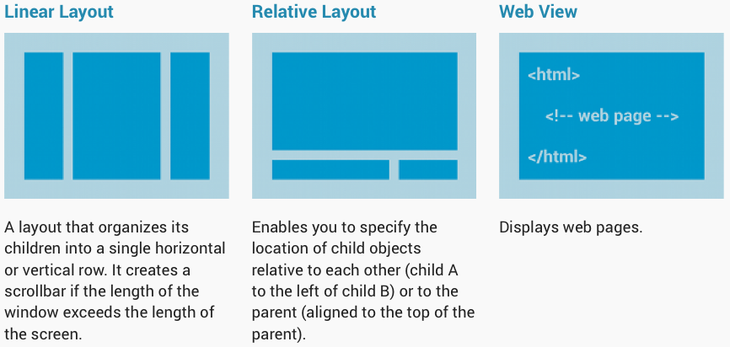
Common layouts
Each subclass of ViewGroup has its own way of managing the placement of the Views that it contains
Try to keep your View hierarchies shallow – otherwise they may take a noticeable time to draw

Slide 22
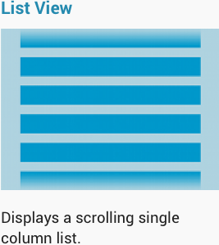
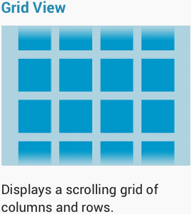
Building layouts with an Adapter
If you want to populate a ViewGroup with child views at runtime, you can define a subclass of AdapterView
An AdapterView uses an Adapter to bind data to its layout
Adapter serves as an intermediary between the AdapterView and a data source
Adapter retrieves data items from a database or an array and converts them into Views that can be added to the AdapterView layout
ListView and GridView are common layouts backed by Adapter

Slide 23
Filling an AdapterView with data
Choose an AdapterView
e.g., GridView or ListView
Bind the AdapterView to an Adapter
retrieves data entries from an external source and creates a View for each entry
Android provides several subclasses of Adapter – most common are
ArrayAdapter
SimpleCursorAdapter

Slide 24
ArrayAdapter
If the data source for your layout is an array, then use an ArrayAdapter
By default:
ArrayAdapter creates a TextView for each item in the array and sets the TextView text using the item’s toString() method

Slide 25
ArrayAdapter
Example shows how to display an array of Strings in a ListView
Construct an ArrayAdapter as above, where arguments are as follows
“this” is the app Context
“android.R.layout.simple_list_item_1” is a reference to the layout that contains a TextView for each String
“myStringArray” is your array of Strings

Slide 26
Using an ArrayAdapter
Once you’ve constructed your ArrayAdapter, you just call setAdapter() on your ListView
You can customise appearance by overriding toString() method for the objects in the array
If you want each item to be displayed in another type of View
extend ArrayAdapter
override getView() to return the type of View you need
e.g., use an ImageView to hold each image in an Array of images

Slide 27
SimpleCursorAdapter
When your data comes from a Cursor, use a SimpleCursorAdapter to adapt it to an AdapterView
Must specify a layout for each row in the Cursor
Must specify which columns in the Cursor are inserted into which Views in the layout
e.g., to display names and numbers of contacts,
specify a String array giving the columns in the Cursor that will be used
specify an array of int IDs giving the corresponding Views for the Cursor columns (see above)

Slide 28
Using a SimpleCursorAdapter
When you instantiate the SimpleCursorAdapter, pass
the layout to use for each result (row)
the Cursor containing the results (rows)
the array of columns
the array of Views
SimpleCursorAdapter creates a View for each row in the Cursor using the layout provided by inserting each item in fromColumns into the corresponding View in toViews
If data in underlying data source changes, send a notifyDataSetChanged() –attached view will refresh itself with the new data

Slide 29
Handling click events
Respond to click events on AdapterView items by implementing the AdapterView.OnItemClickListener interface
Then set the AdapterView’s OnItemClickListener to an instance of this implementation

Slide 30
LinearLayout
LinearLayout is a ViewGroup that aligns all its children in a single row or column
Direction specified with android:orientation attribute
Horizontal list will be height of the tallest element
Vertical list will be width of the widest element
LinearLayout respects margins between children and gravity of each child
gravity is right, center, or left alignment

Slide 31
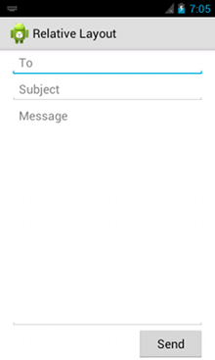
Layout weight in LinearLayout
In LinearLayout, can assign a weight to each child with android:layout_weight attribute
Remaining space is allocated in proportion to the assigned weight of the children
Default weight is 0
If three text fields have weights, 1, 1 and 0, then
third text field is only big enough to contain its content
other two share equally the space remaining after all three fields are measured

Slide 32
LinearLayout in which elements are equally sized
Set android:layout_height (for vertical layout) to “0dp”
Set android:layout_width (for horizontal layout) to “0dp”
Set android:layout_weight of each view to 1

Slide 33
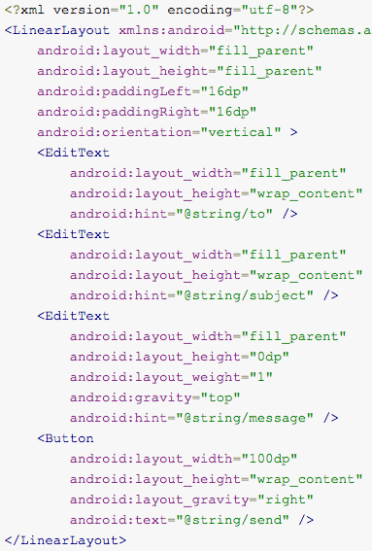
LinearLayout Example

Slide 34
RelativeLayout
RelativeLayout displays children in positions relative to each other (siblings)...
e.g., “left-of” or “below” a sibling
...or relative to the parent RelativeLayout area
e.g., aligned to the bottom, left of centre

Slide 35
RelativeLayout
RelativeLayout can eliminate nested ViewGroups and keep the View hierarchy flat
improves performance!
Can sometimes replace several nested LinearLayouts with a single RelativeLayout

Slide 36
Positioning Views
RelativeLayout lets child views specify their positions relative to each other and the containing Layout
e.g., align two elements by right border, make one below another, centered in the screen, centered left, etc.
By default, all child Views drawn in the top-left of the layout
Define positions using layout properties available from RelativeLayout.LayoutParams

Slide 37
Examples of layout properties
android:layout_alignParentTop
if “true” then top edge of View matches top edge of parent
android:layout_centerVertical
if “true”, child centered vertically in parent
android:layout_below
Top edge of this View below View specified with resource ID
android:layout_toRightOf
Left edge of this View to the right of View specified with resource ID
There are many more RelativeLayout layout attributes!

Slide 38
RelativeLayout layout properties
Value for a layout property in RelativeLayout is either
a boolean – enables layout position relative to parent RelativeLayout
an ID – references another View in Layout relative to which this View should be positioned
Views can be declared in any order in the XML layout file
so a View can depend on a View that is declared later in the XML file

Slide 39
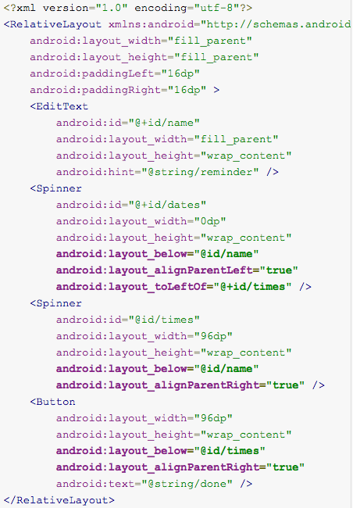
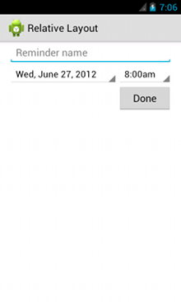
Example of RelativeLayout

